Slide 1

NLP-Based Resume Screening Application
Author: Abhishek Bargujar
Professor: Tessaris Sergio
Project Link : git@gitlab.inf.unibz.it:Abhishek.Bargujar/resume_screeing_ai.git
link no.2:-> https://gitlab.inf.unibz.it/Abhishek.Bargujar/resume_screeing_ai

Slide 2

Introduction
Introduction to the Project
Objective: Develop an NLP-based application to automate the process of categorizing resumes and extracting key information.
Importance: Enhances recruitment efficiency by reducing manual effort and improving accuracy in candidate selection.

Slide 3


Problem Statement
Dataset: Collection of resumes labeled by job category.
Structure: Resumes contain sections like contact information, work experience, education, skills, and certifications.
Primary Challenge: Accurately classify resumes into predefined job categories and extract essential information such as candidate name, known technologies, and skills.

Slide 4
Approach
Data Preprocessing:
Clean the resume text to remove unwanted characters and standardize the format.
Feature Extraction:
Use Term Frequency-Inverse Document Frequency (TF-IDF) to transform textual data into numerical features.
Model Training:
Train a classification model using the preprocessed dataset to categorize resumes based on extracted features.
Named Entity Recognition (NER):
Implement NER to extract key details such as candidate names and known technologies from the resumes.
Application Development:
Develop a web application using Streamlit for users to upload resumes, view predicted job categories, and extract key information.

Slide 5
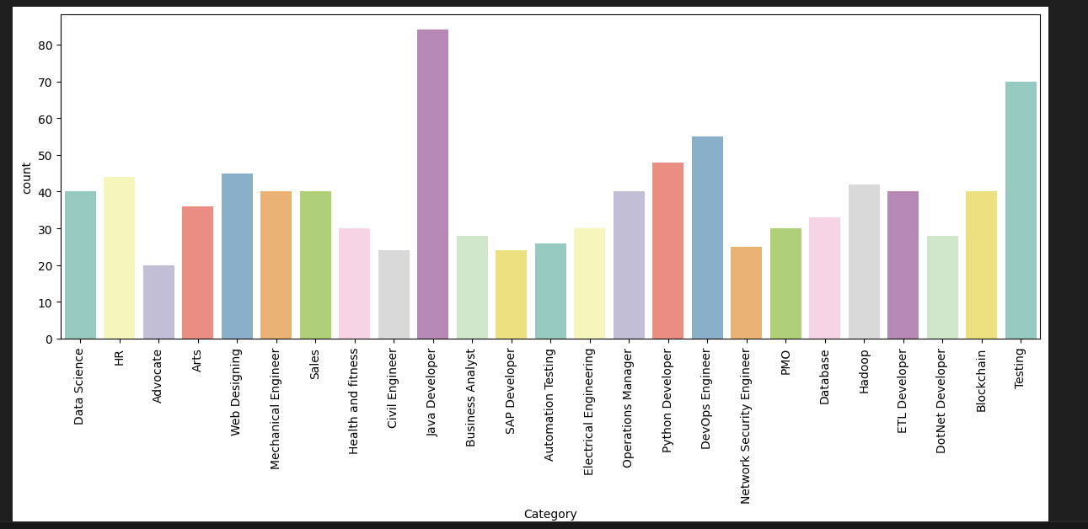
JOB GRAPH

Slide 6

Data Preprocessing
Data Cleaning and Standardization
Objective: Remove unwanted characters and standardize the resume text.
Techniques:
Removal of URLs, special characters, and extra spaces using regular expressions.
Conversion to lower case to maintain consistency.

Slide 7
Feature Extraction
Transforming Text Data into Numerical Features
Technique: Term Frequency-Inverse Document Frequency (TF-IDF).
Purpose: Convert textual data into a matrix of token counts, which are then transformed into normalized term frequencies.

Slide 8

Model Training
Training the Classification Model
Approach:
Preprocess the dataset.
Use TF-IDF for feature extraction.
Train a classification model to categorize resumes into job categories based on extracted features.
Tools: scikit-learn library for model training and evaluation.

Slide 9

Named Entity Recognition (NER)
Extracting Key Information from Resumes
Objective: Identify and extract candidate names and known technologies.
Methods:
Regular expressions to locate names and technologies.
Predefined lists of technologies for various job categories.

Slide 10
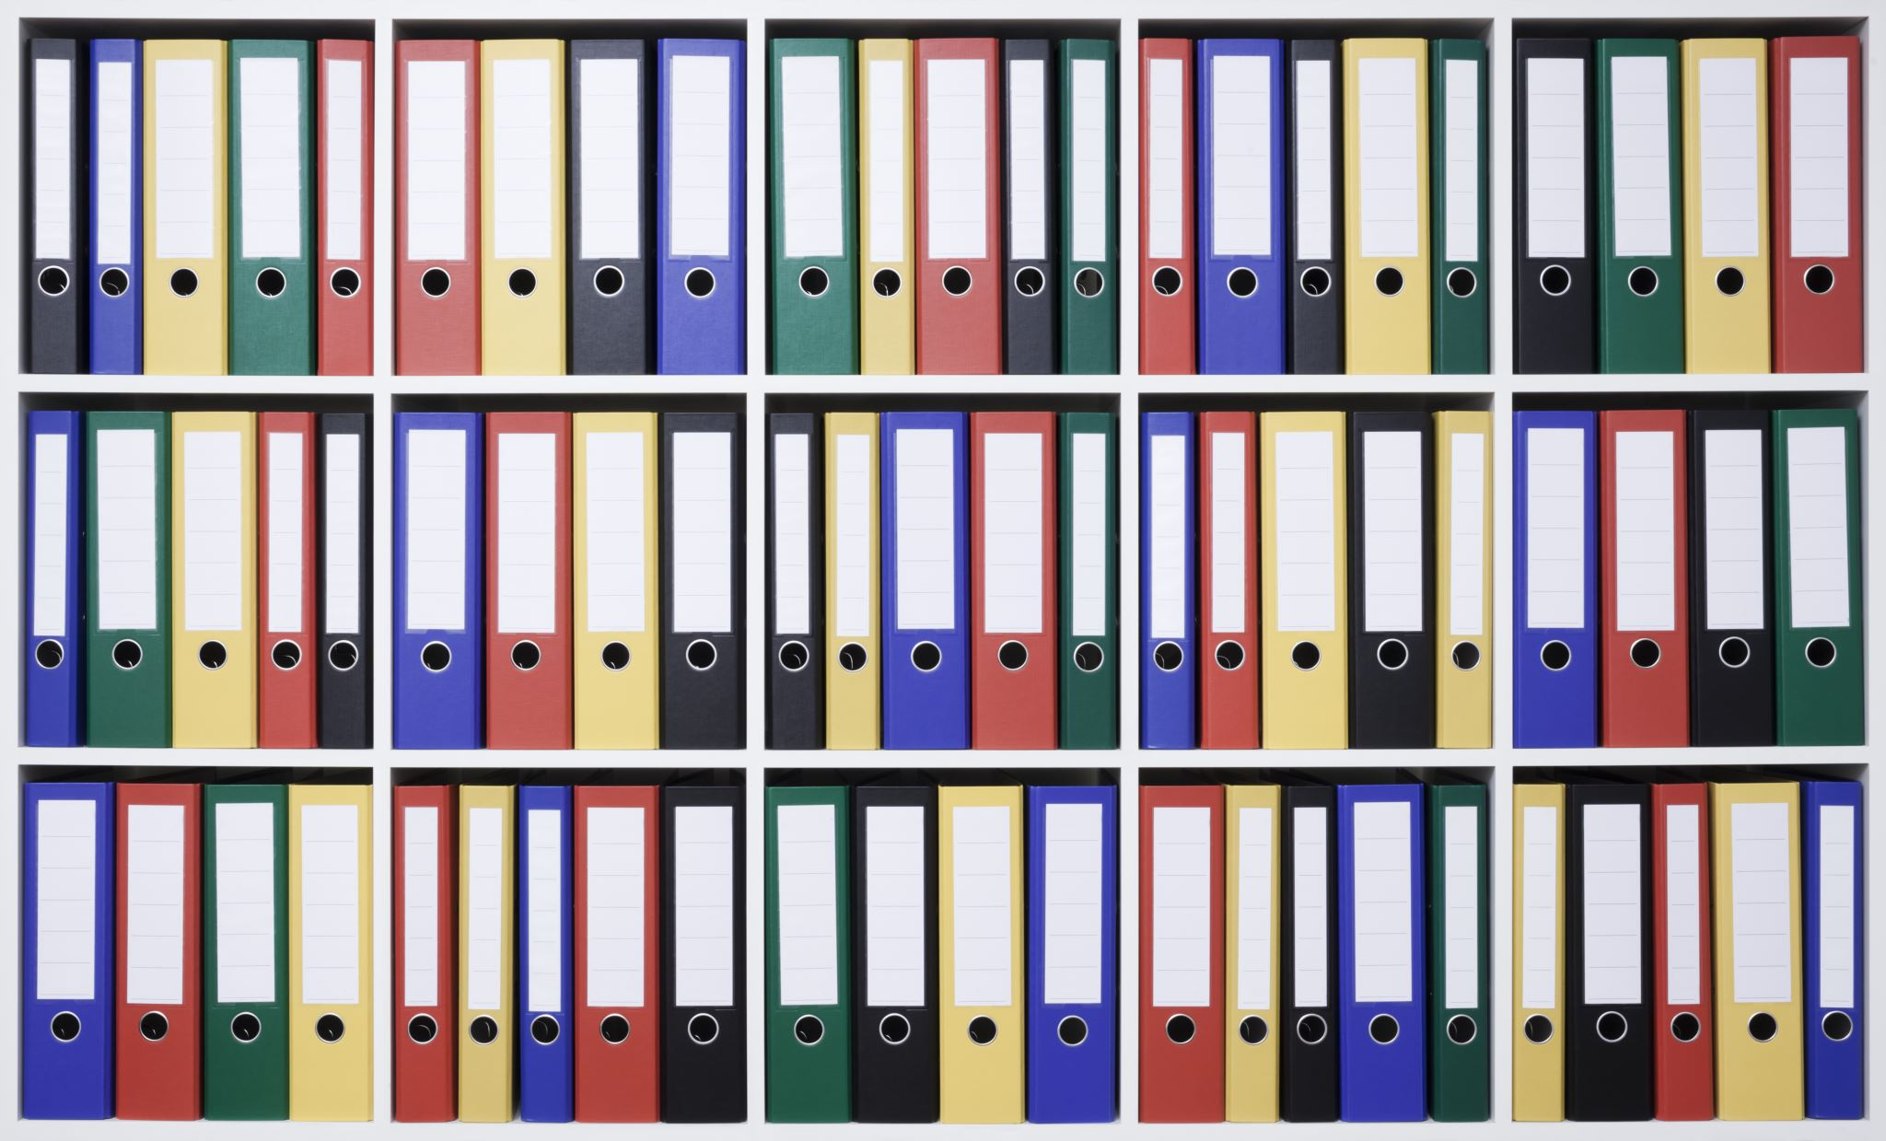
Solution Implementation
Data Preprocessing:
Cleaning includes removing URLs, special characters, and extra spaces using regular expressions.
Feature Extraction with TF-IDF:
Converts text data into a matrix of token counts which are then transformed into normalized term frequencies.
Classification Model:
A machine learning model is trained using scikit-learn to predict job categories based on TF-IDF features.
NER for Information Extraction:
Regular expressions and predefined lists of technologies are used to identify candidate names and skills.
Web Application:
Streamlit-based interface where users upload resumes, the system processes and displays predicted categories, candidate names, known technologies, and job search links.

Slide 11

Regular Expressions (re)
Regular Expressions (re) are sequences of characters that define search patterns, primarily used for string matching and manipulation. In Python, the re module provides a set of functions to work with regular expressions.
Common Functions in re Module:
re.match(): Checks for a match only at the beginning of the string.
re.search(): Searches for a match anywhere in the string.
re.findall(): Finds all matches and returns them as a list.
re.sub(): Replaces one or many matches with a string.
import re
pattern = r'\bword\b’
text = 'A word in a sentence.’
match = re.search(pattern, text)
if match: print("Match found:", match.group())
else: print("No match found")

Slide 12

Label Encoder
Label Encoder is a tool in machine learning used to convert categorical labels into numerical values. This is essential for algorithms that require numerical input. The LabelEncoder class from the scikit-learn library is commonly used for this purpose.

Slide 13

Scikit-learn
Scikit-learn is a popular open-source machine learning library in Python. It provides simple and efficient tools for data mining, data analysis, and machine learning. It is built on NumPy, SciPy, and matplotlib.
Key Features:
Supervised Learning: Linear models, Support Vector Machines, Decision Trees, etc.
Unsupervised Learning: Clustering, PCA, etc.
Model Selection: Cross-validation, Grid Search, etc.
Preprocessing: Standardization, normalization, etc.

Slide 14
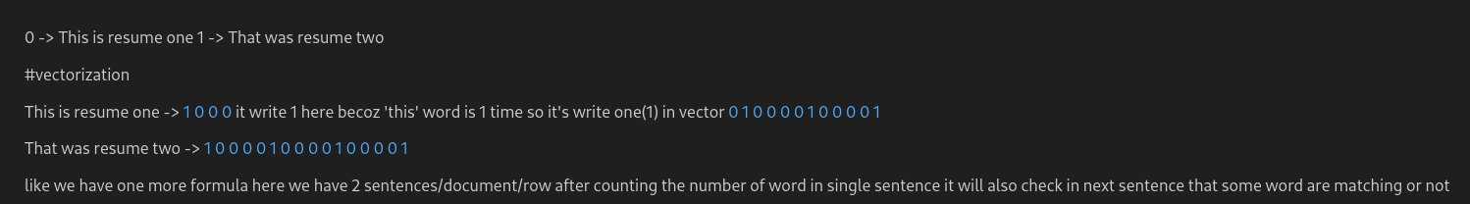
Vectorization
Vectorization is the process of converting textual data into numerical vectors that can be used for machine learning models. This involves transforming text into a format that models can understand.
Methods of Vectorization:
Bag of Words (BoW): Represents text as a collection of word counts.
TF-IDF: Represents text by considering the frequency and importance of words.

Slide 15

TF-IDF Vectorizer
TF-IDF (Term Frequency-Inverse Document Frequency) is a statistical measure used to evaluate the importance of a word in a document relative to a collection of documents (corpus). The TF-IDF Vectorizer converts text into vectors based on this measure.
Formula:
Term Frequency (TF): Frequency of a word in a document.
Inverse Document Frequency (IDF): Logarithmically scaled inverse fraction of the documents that contain the word.

Slide 16
Classifier as Binary Files Using Pickle
Pickle is a Python module used for serializing and deserializing Python objects. This allows saving machine learning models as binary files for later use.
Steps to Save and Load a Classifier:
Train the model.
Save the model using pickle.
Load the model when needed.

Slide 17
Application Development
Developing the Web Application
Platform: Streamlit for building a user-friendly interface.
Functionality:
Users can upload resumes.
System processes the resumes, predicts job categories, and extracts key information.
Displays results and provides job search links.

Slide 18

Detailed Application Code Overview
Key Components of the Application (app.py)
Imports and Setup:
Streamlit, Pickle, re, nltk.
Model Loading:
Pre-trained classifier (clf.pkl) and TF-IDF vectorizer (tfidf.pkl).

Slide 19
Cleaning Function
Function: CleanResume
Purpose: Clean the resume text by removing unwanted characters and standardizing the format.

Slide 20
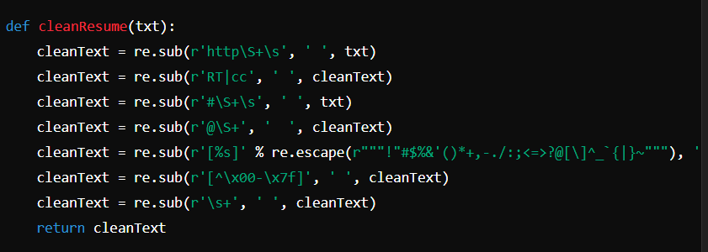
Code

Slide 21
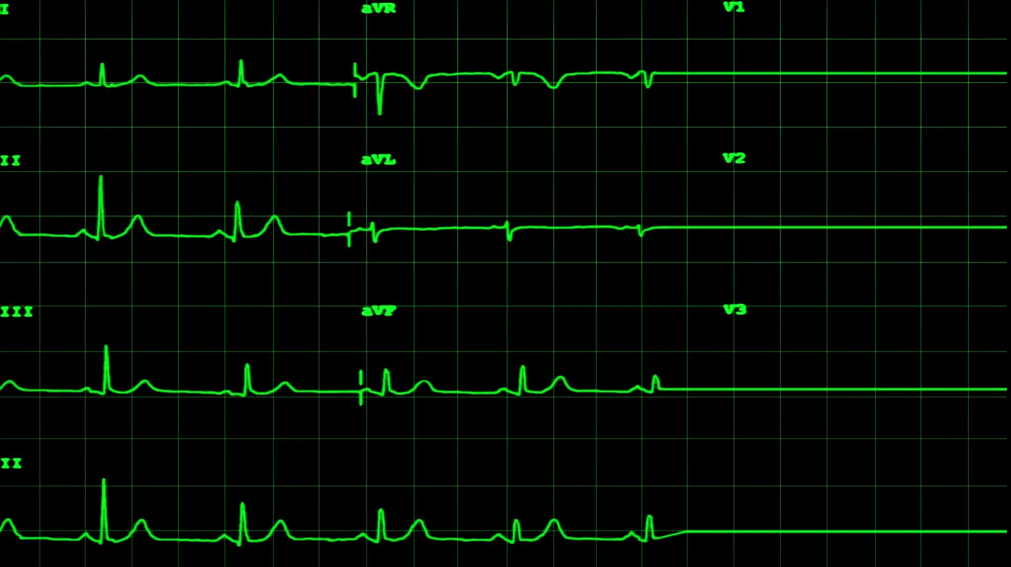
Name Extraction Function
Function: extract_candidate_name
Purpose: Extract the candidate's name using patterns such as "My name is" and typical name formats.

Slide 22
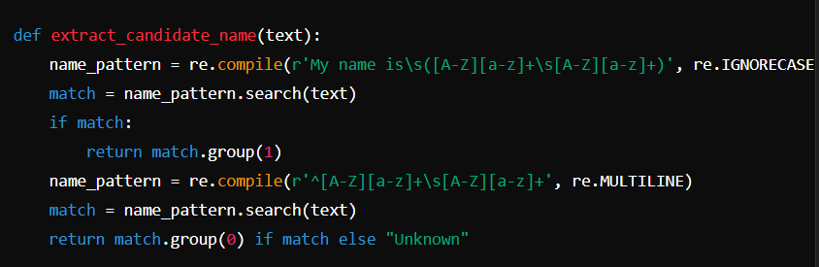
Name Extraction Function

Slide 23

Technologies Extraction Function
Function: extract_technologies
Purpose: Identify technologies mentioned in the resume from predefined lists.

Slide 24
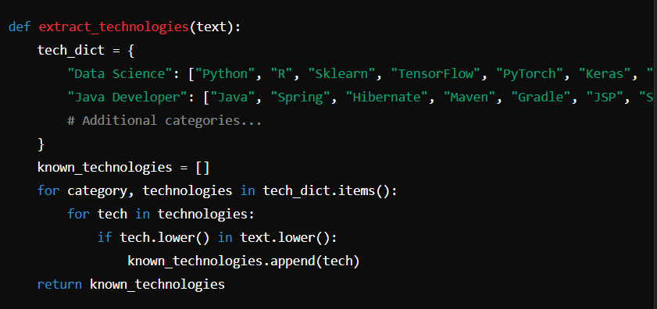
Technologies Extraction Function

Slide 25

Job Search Links Function
Function: generate_job_search_links
Purpose: Generate links to job search portals for the predicted job category.

Slide 26
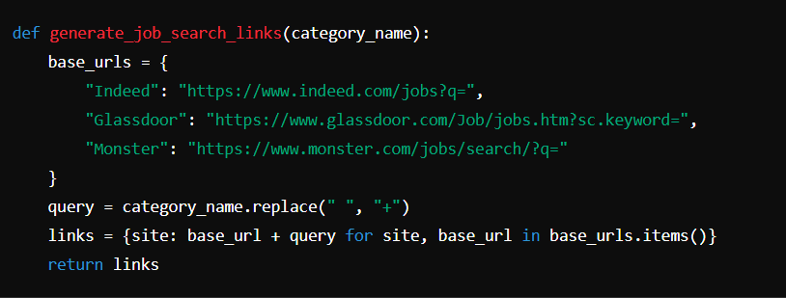
Job Search Links Function

Slide 27
Web Application Interface
Objective: Provide a user-friendly interface for uploading and processing resumes.
Key Features:
Resume upload.
Resume processing and prediction.
Display of results and job search links.

Slide 28
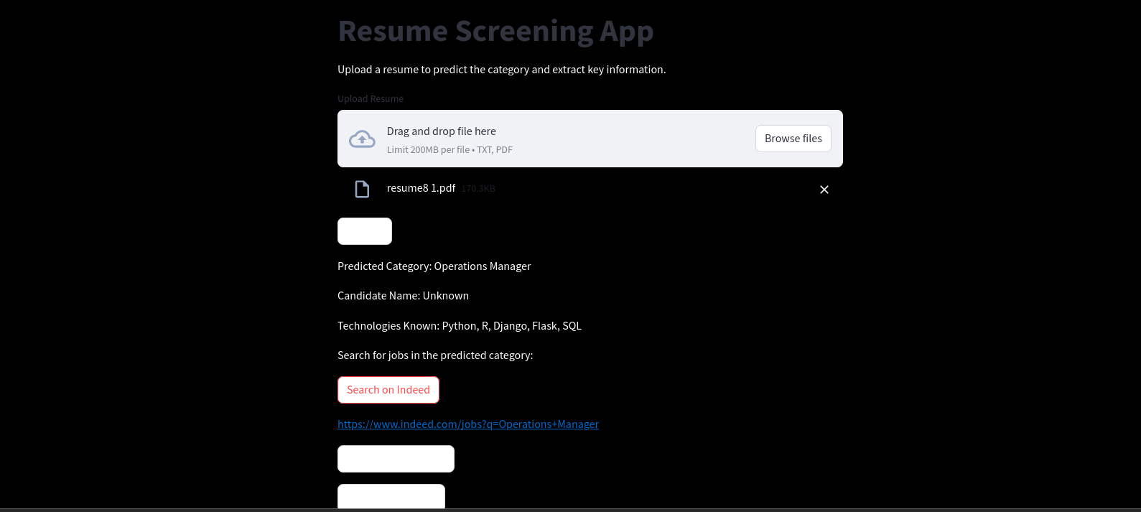
Web App Interface

Slide 29
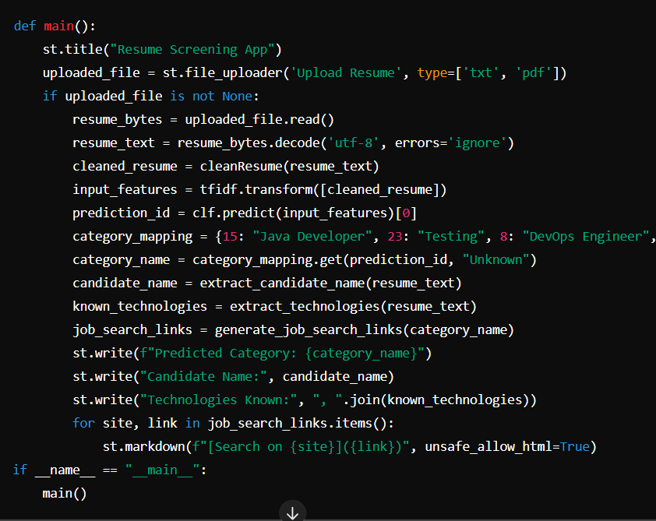
Web Application Interface code

Slide 30
Results and Benefits
Efficiency: Automation reduces manual effort in resume screening.
Accuracy: NLP and machine learning techniques ensure precise categorization and information extraction.
User-Friendly: Intuitive interface allows easy interaction for recruiters.

Slide 31
Conclusion
Final Thoughts
Summary: The NLP-based resume screening application enhances the recruitment process by automating resume categorization and information extraction.
Future Work: Further improvements can be made by incorporating more advanced NLP techniques and expanding the range of job categories and technologies.

Slide 32

References
Bird, S., Klein, E., & Loper, E. (2009). Natural Language Processing with Python: Analyzing Text with the Natural Language Toolkit. O'Reilly Media, Inc.

Slide 33

Thank you!

